Slide 1
t-SNE and UMAP
https://www.youtube.com/watch?v=NEaUSP4YerM&t=1s
https://www.youtube.com/watch?v=jth4kEvJ3P8
https://www.youtube.com/watch?v=eN0wFzBA4Sc

Slide 2
t-SNE (t-Distribution Stochastic Neighborhood)
Determine high-dimensional similarities
Similarity distance calculation
Convert similarity distance to probability (normal distribution)
Build similarity matrix S1 for every point
Determine low-dimensional similarities
Randomly arranges all points on the required lower dimensional
Similarity distance calculation
Convert similarity distance to probability (t-distribution)
Build similarity matrix S2 for every point
Compare matrix S1 and S2
Move all points

Slide 3
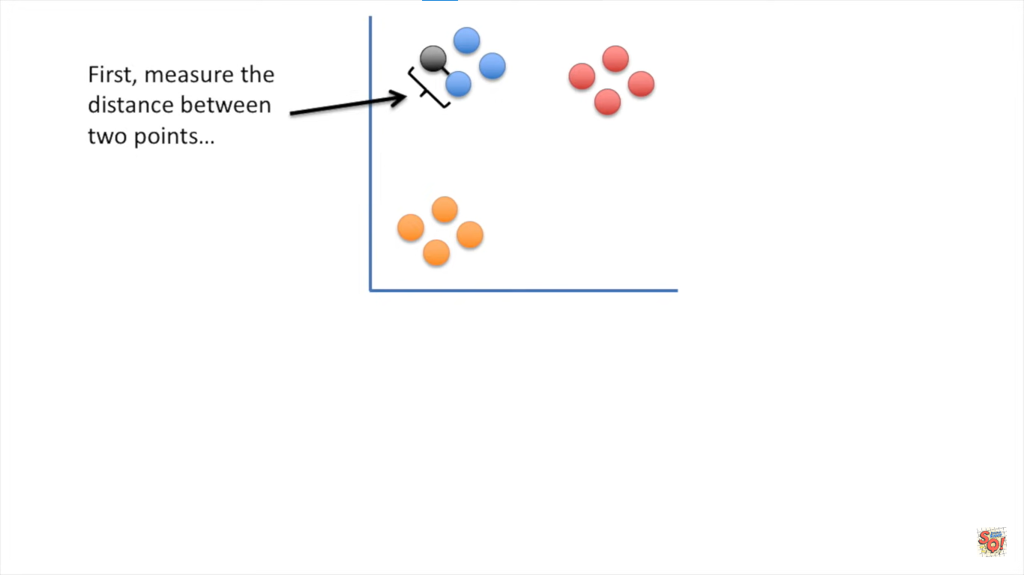
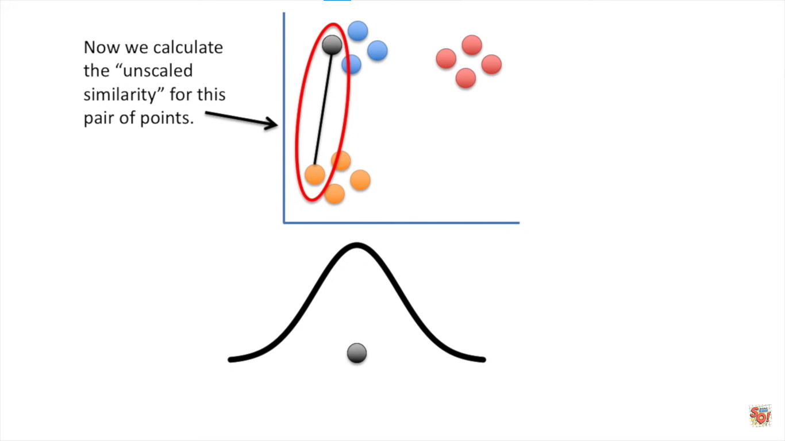
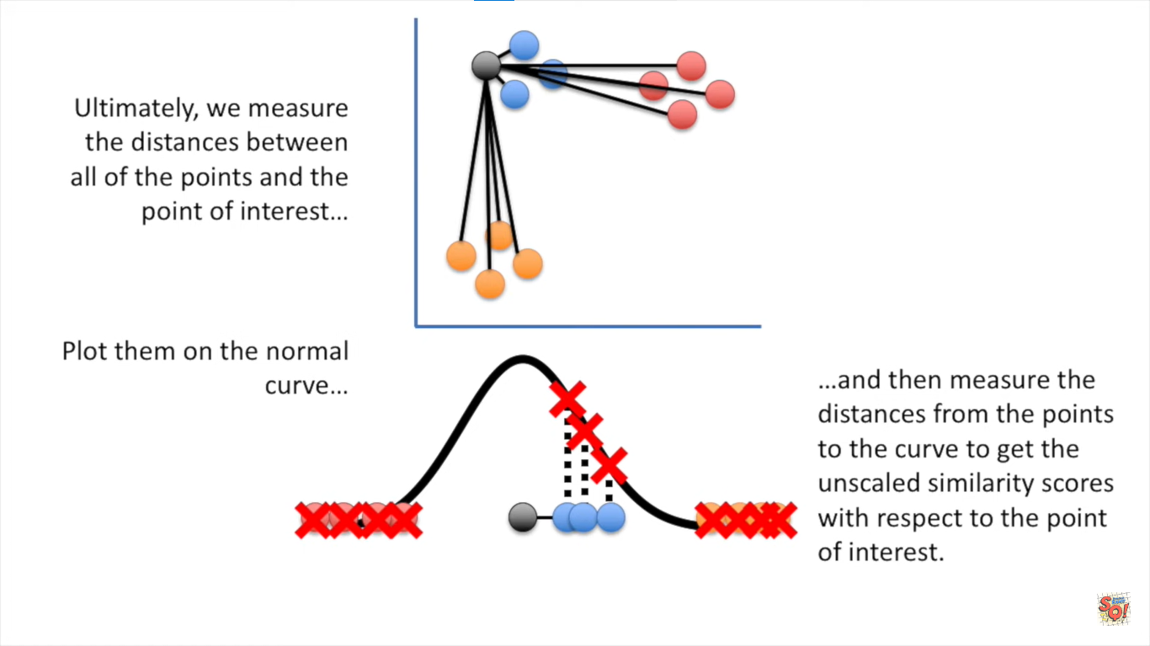
1. Similarity distance calculation

Slide 4
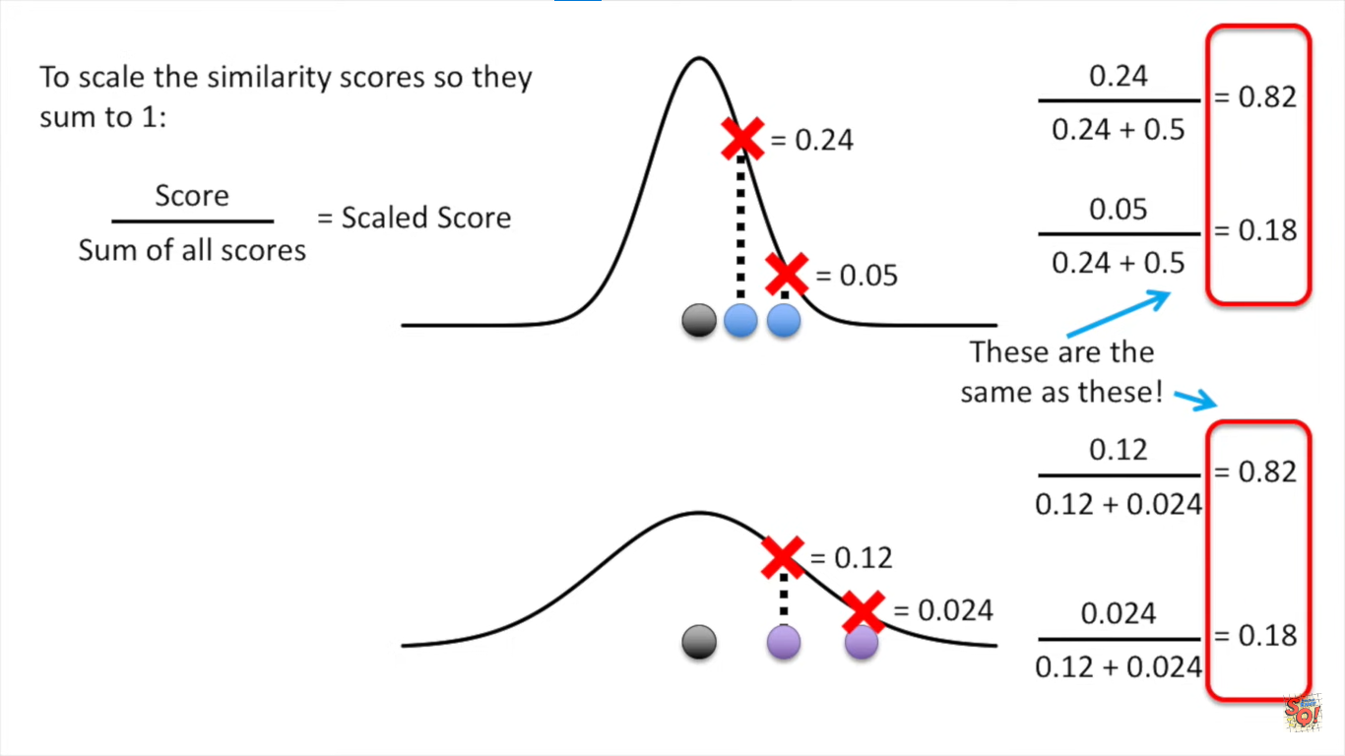
2. Similarity distance to probability (normal distribution)

Slide 5
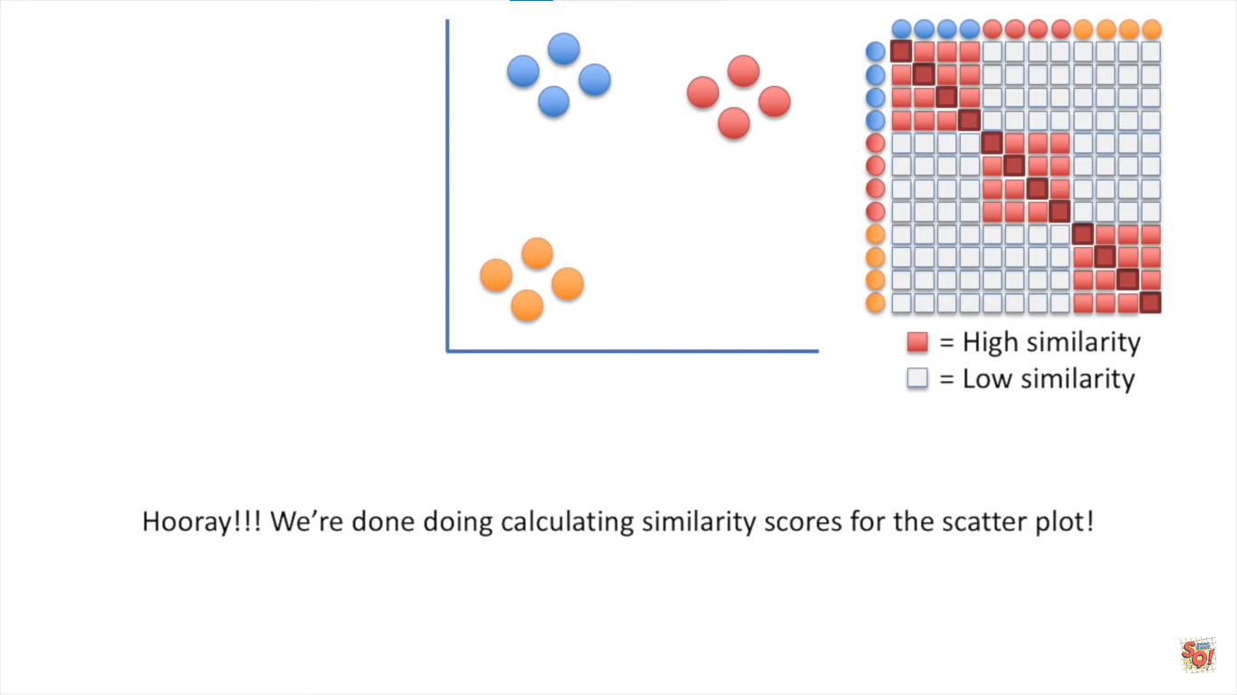
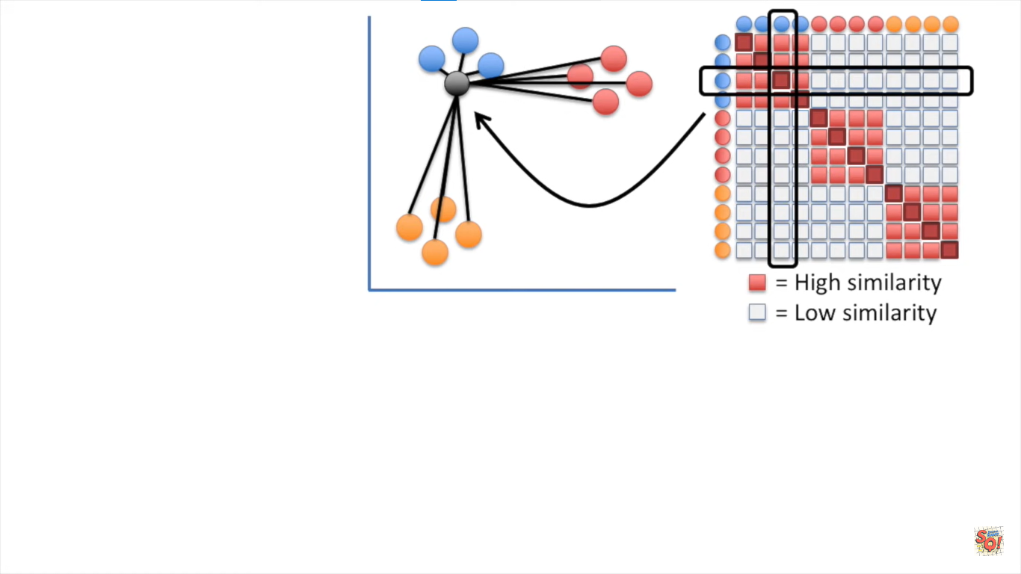
3. Similarity matrix S1

Slide 6
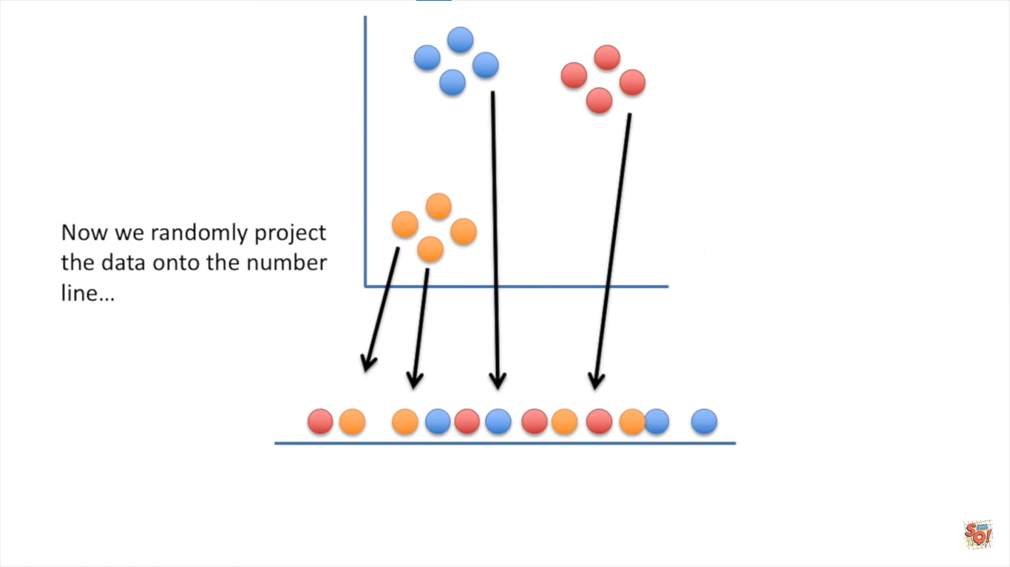
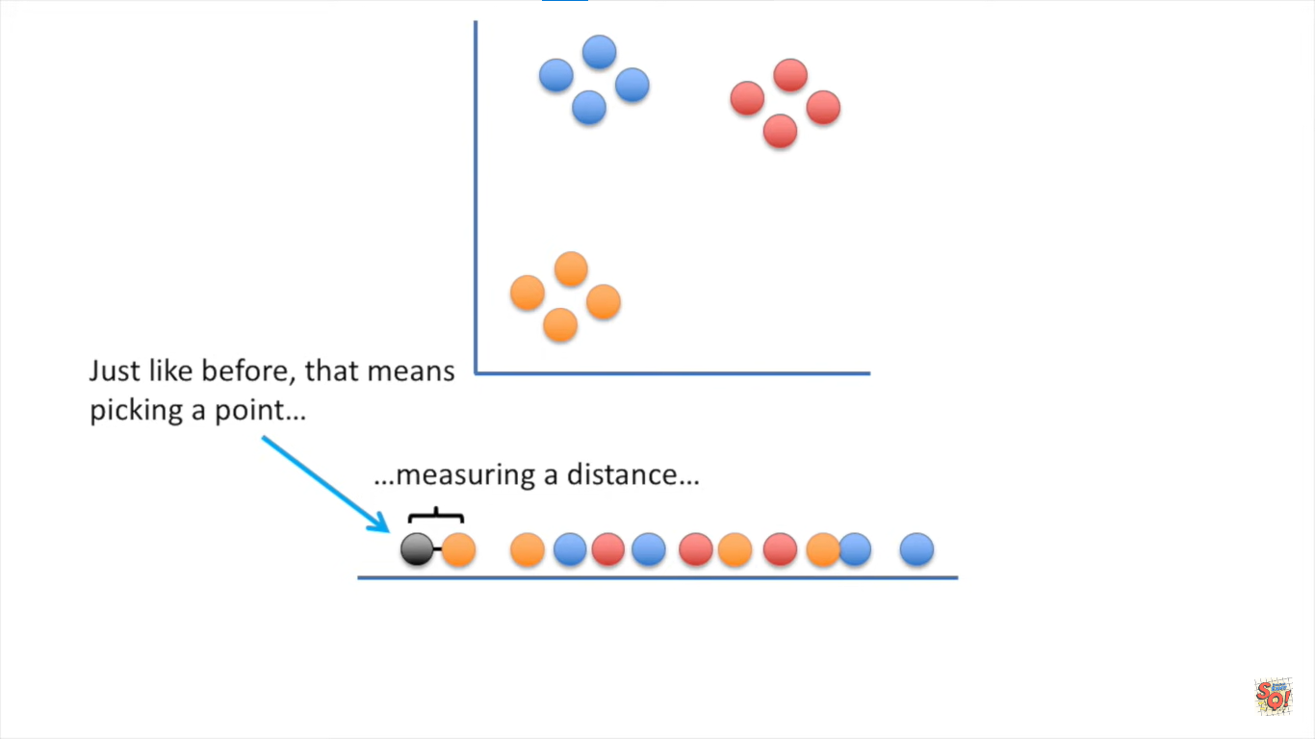
4. Arranges all points on lower dimension
5. Similarity distance calculation

Slide 7
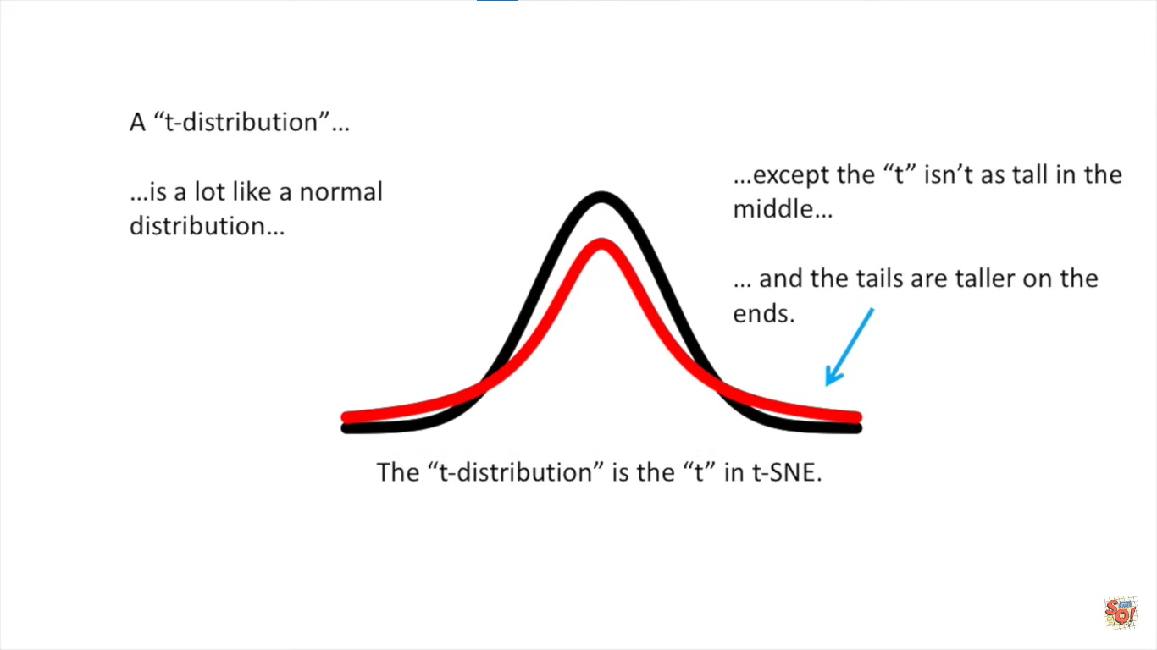
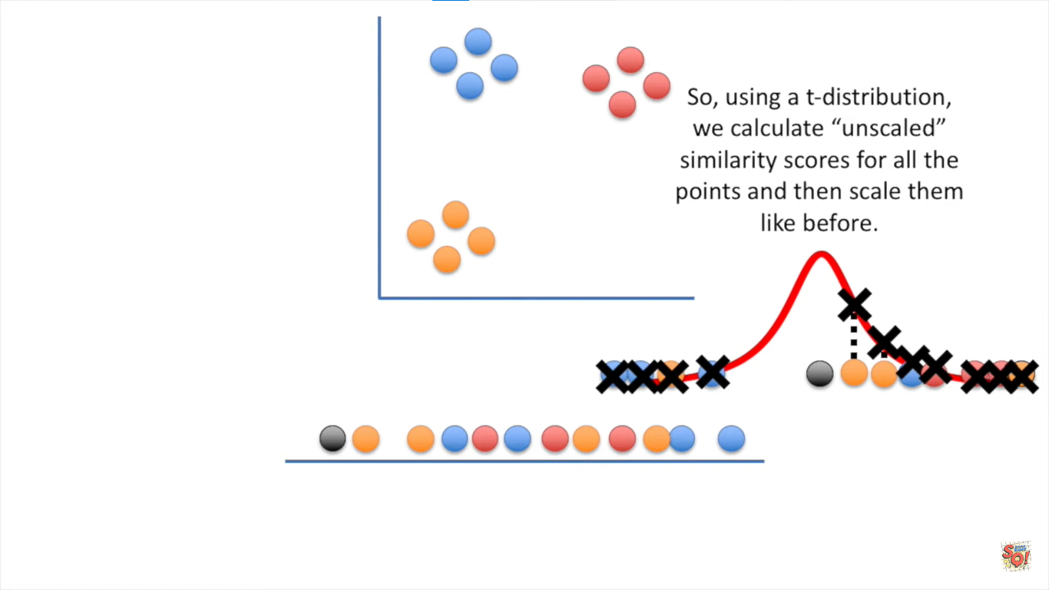
6. Similarity distance to probability (t-distribution)

Slide 8
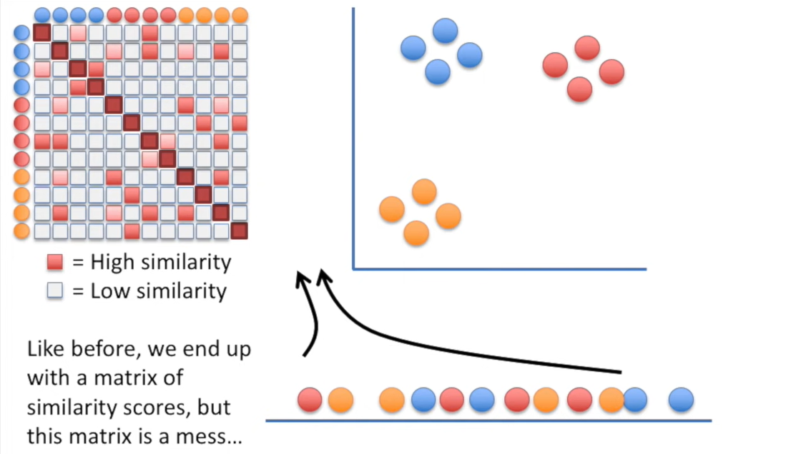
7. Build similarity matrix S2

Slide 9
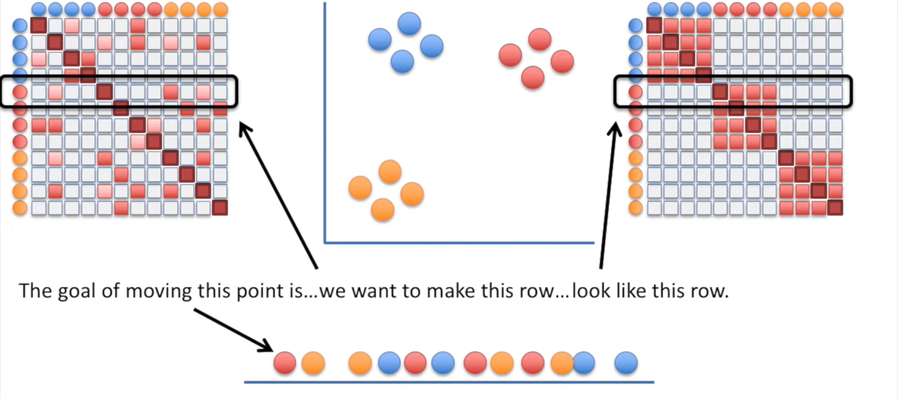
8. Compare matrix S1 and S2

Slide 10
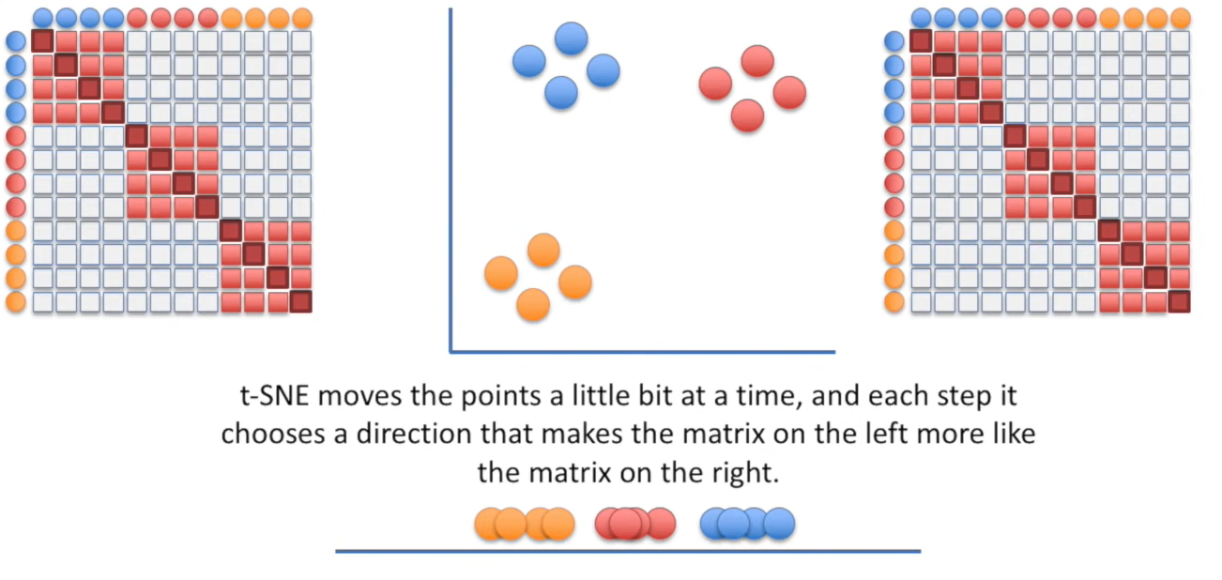
9. Move all points

Slide 11
UMAP (Uniform Manifold Approximation and Projection)
Calculating high-dimensional similarity scores
Making the scores symmetrical
Calculating low-dimensional similarity scores
Moving the low-dimensional points

Slide 12
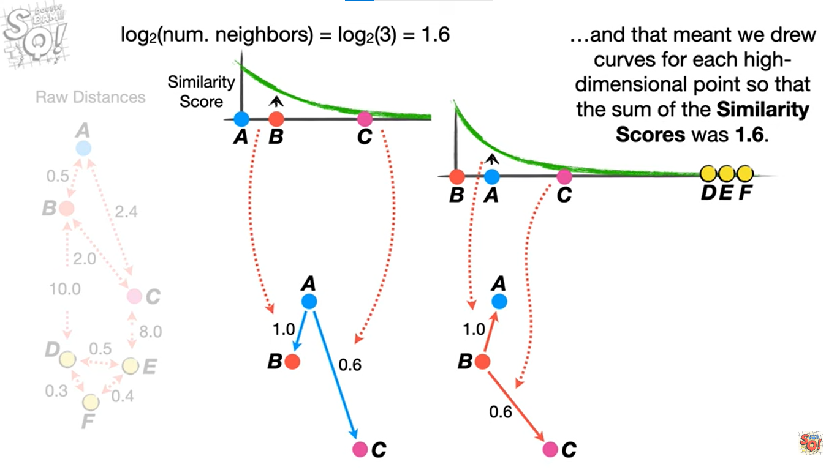
1. Calculating high-dimensional similarity scores

Slide 13
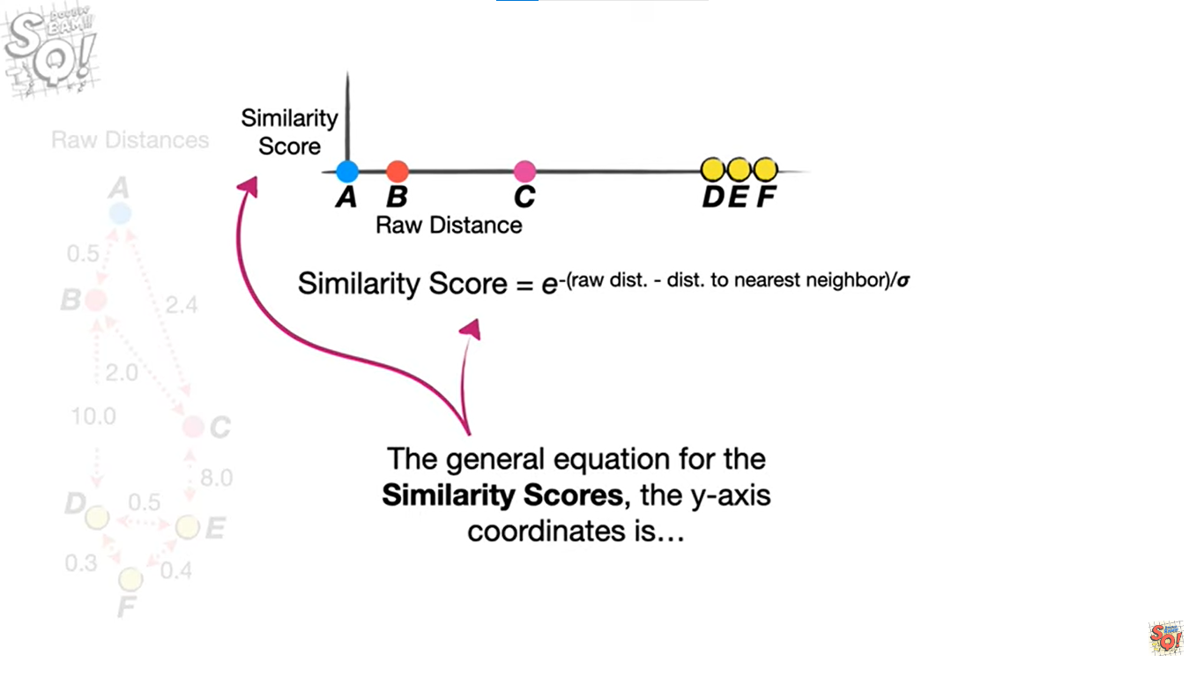
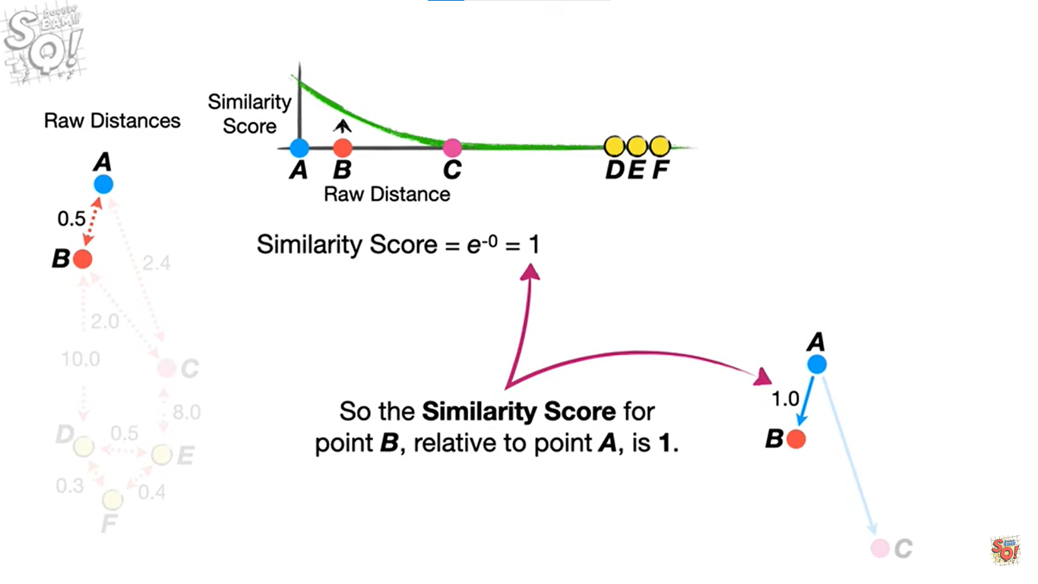
1. Calculating high-dimensional similarity scores

Slide 14
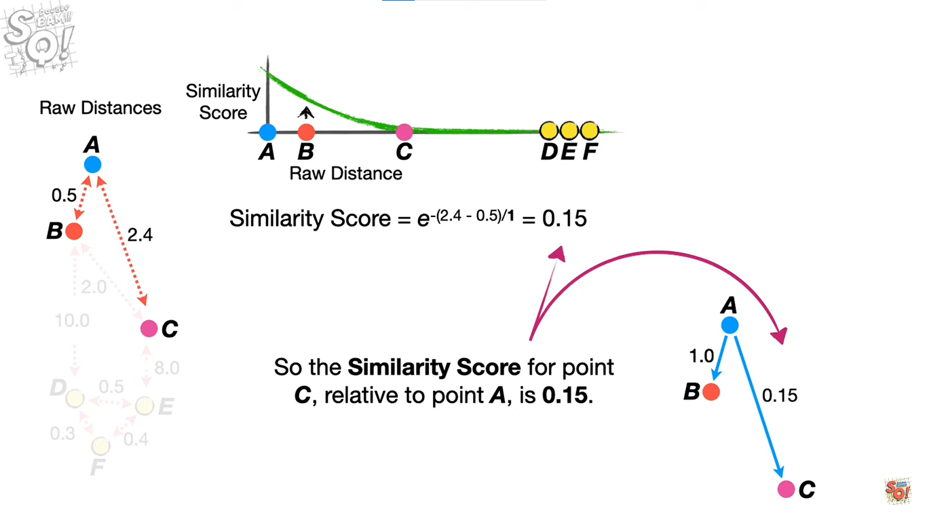
1. Calculating high-dimensional similarity scores

Slide 15
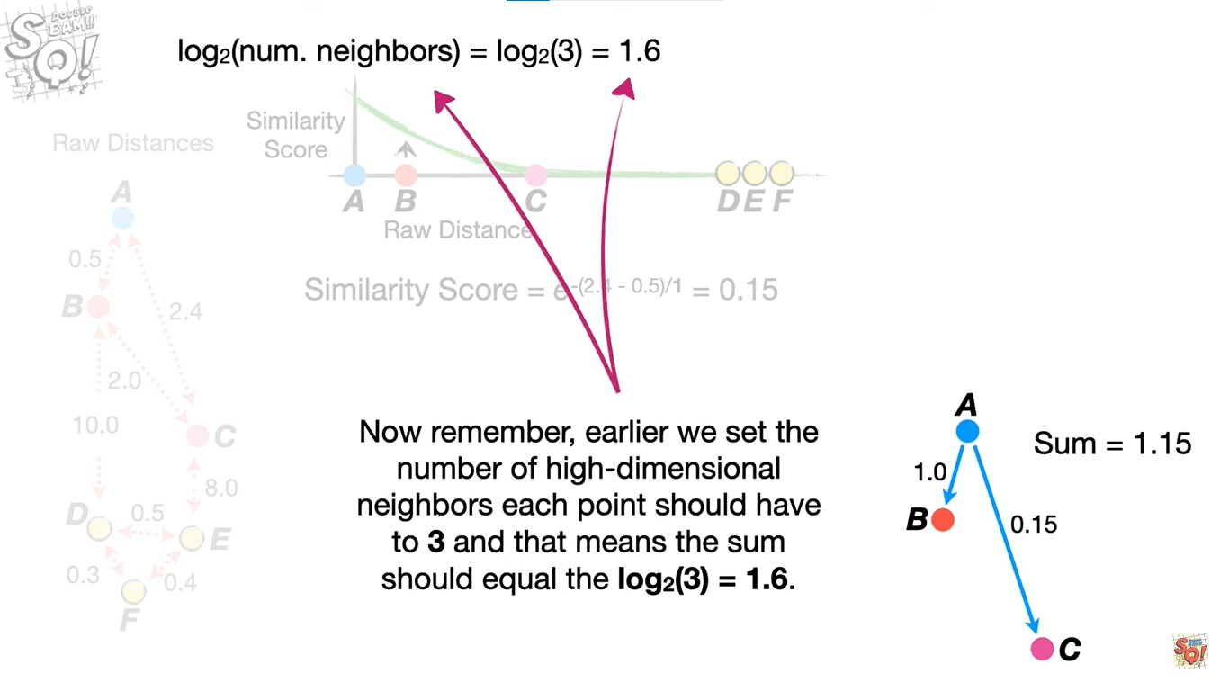
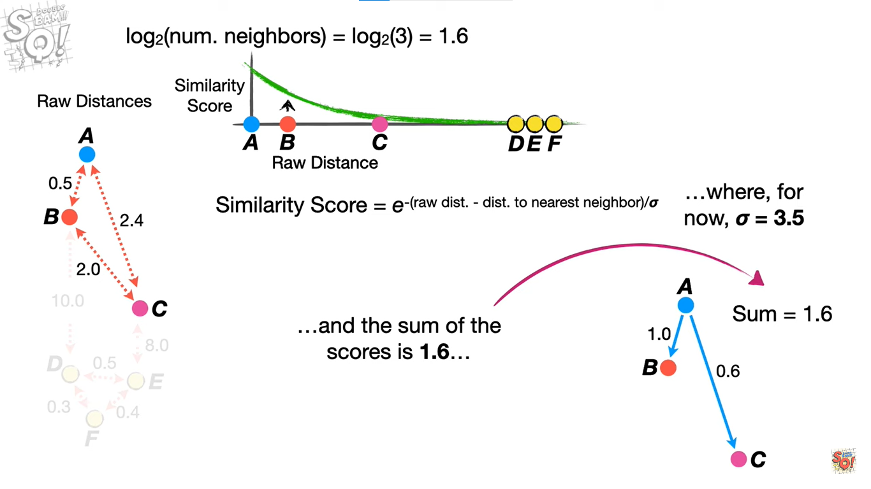
1. Calculating high-dimensional similarity scores

Slide 16
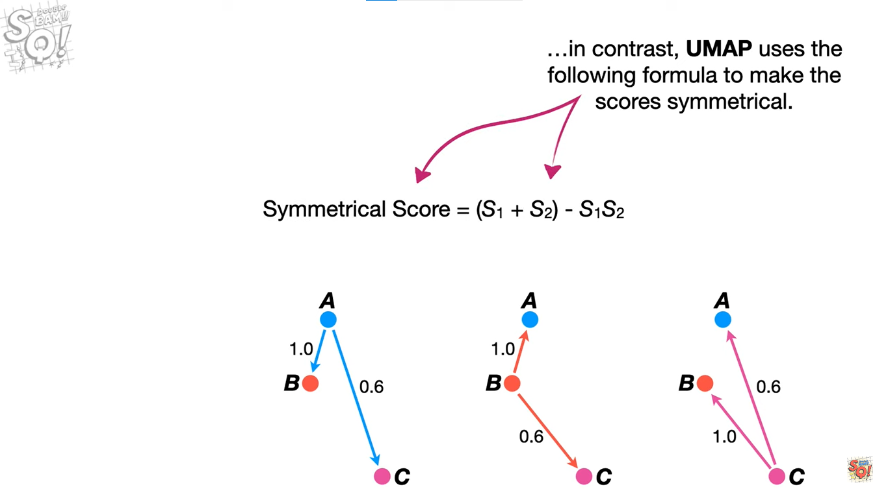
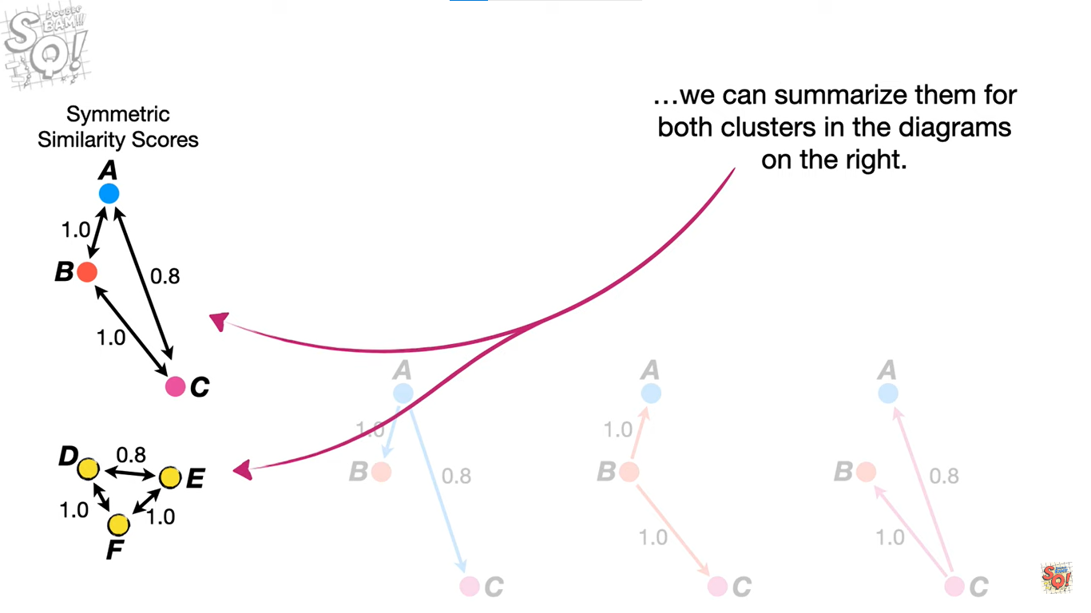
2. Making the scores symmetrical

Slide 17
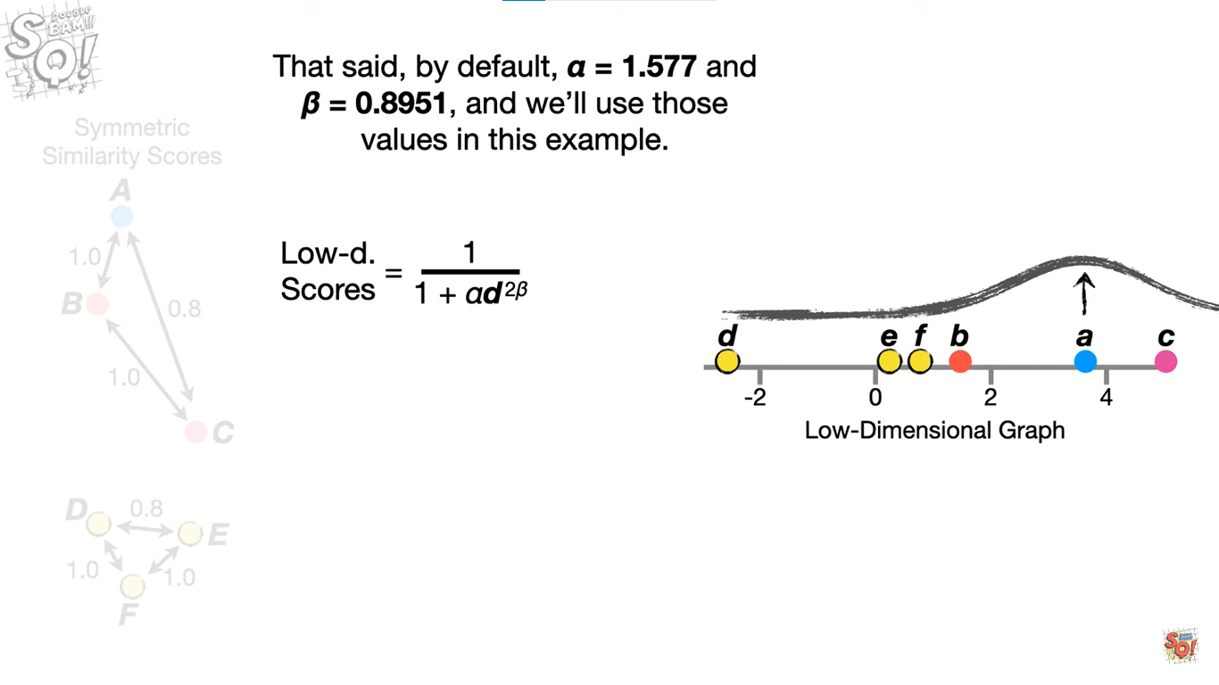
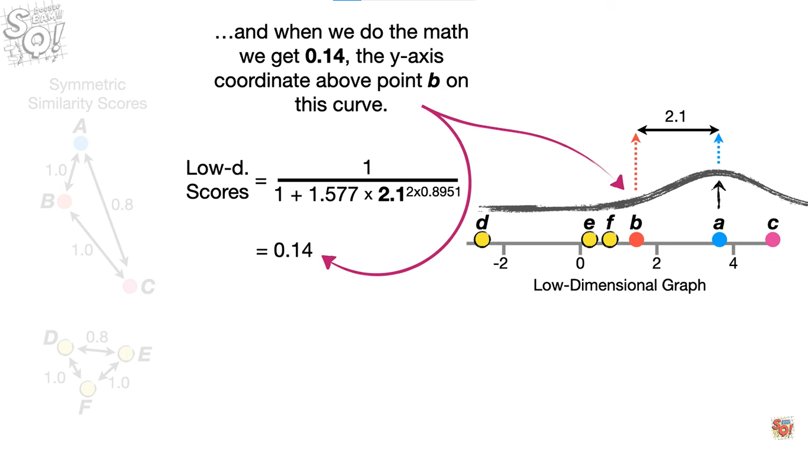
3. Calculating low-dimensional similarity scores

Slide 18
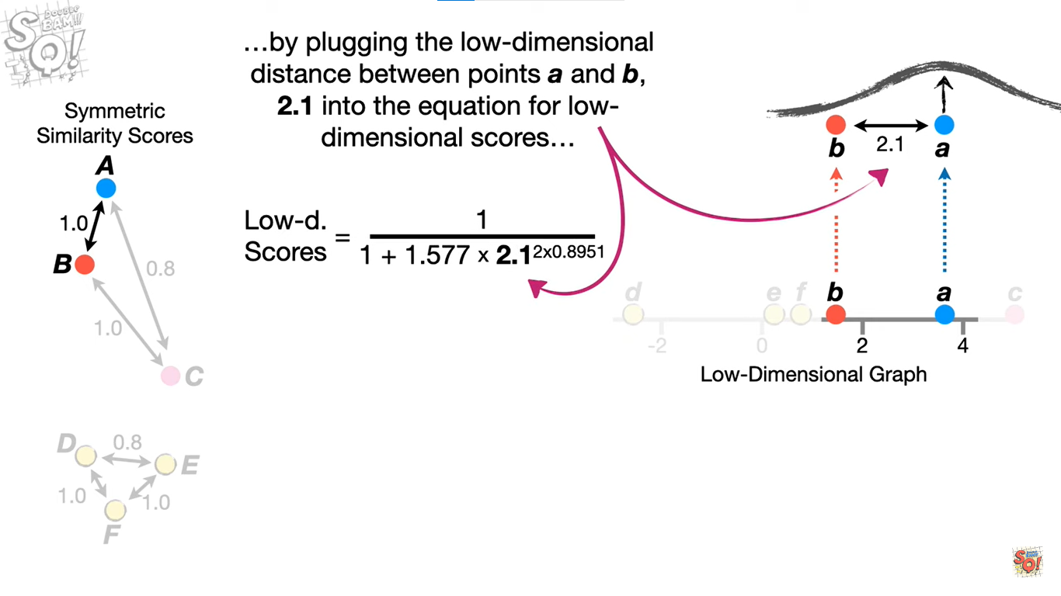
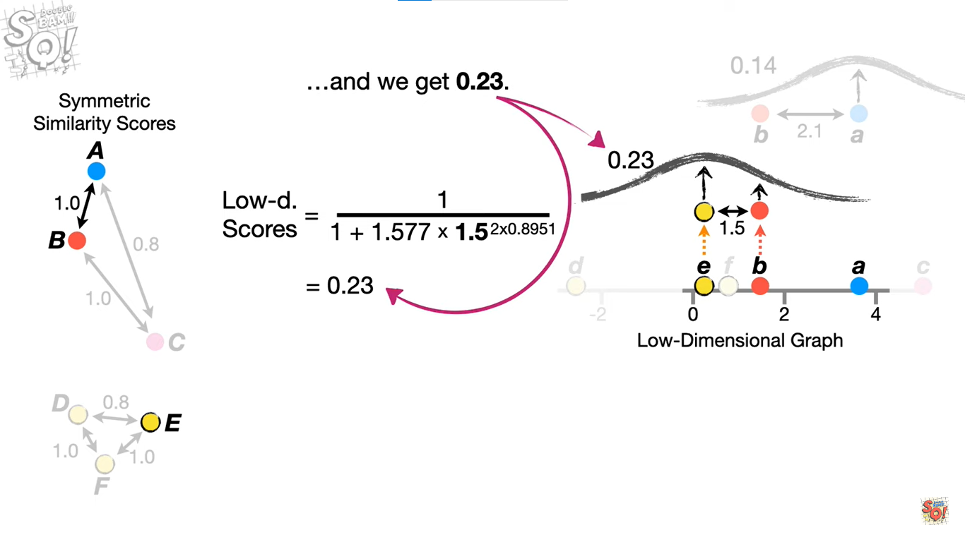
3. Calculating low-dimensional similarity scores

Slide 19
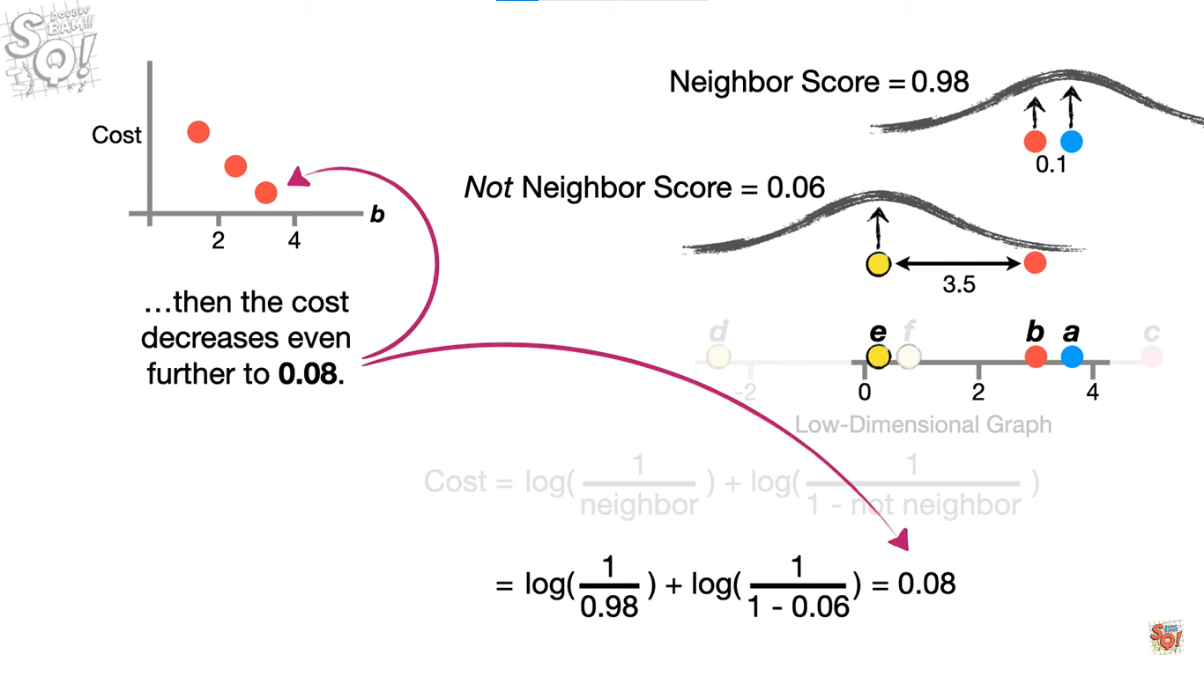
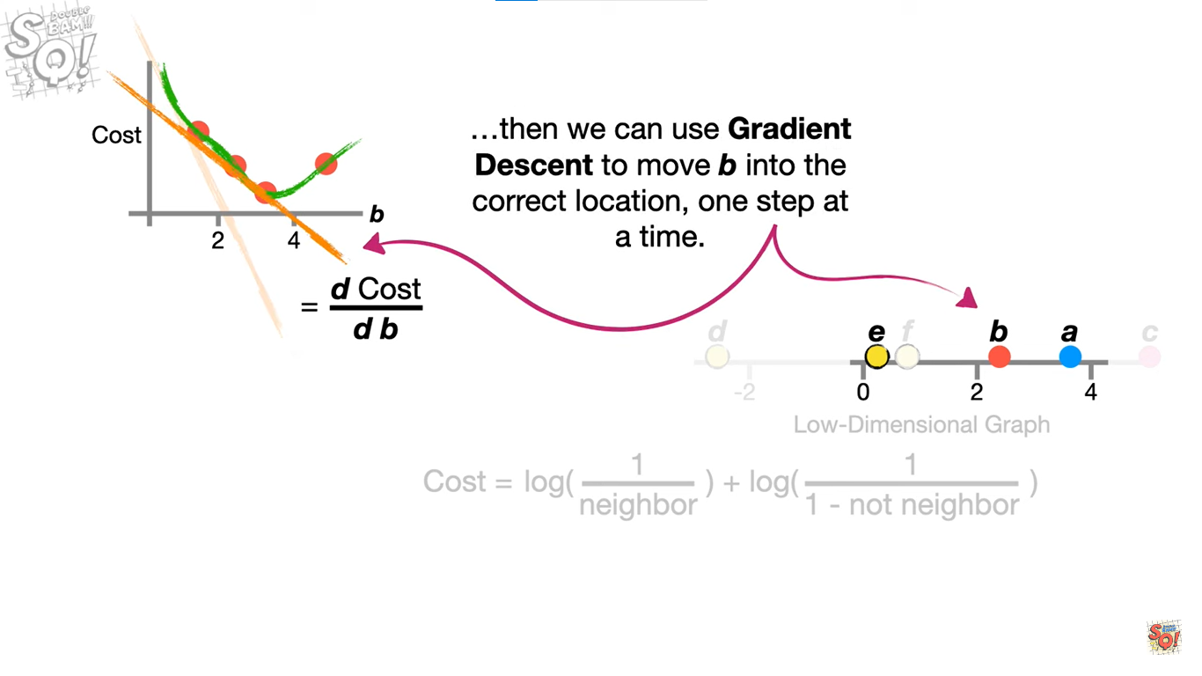
4. Moving the low-dimensional points

